Slide 1
Leading The Way The Senior Student Language Ambassador Team
Dr Elizabeth Andersen, Liam Innis, Sophie Stewart & Ruta Vaiciute
Routes into Languages North East

Slide 2
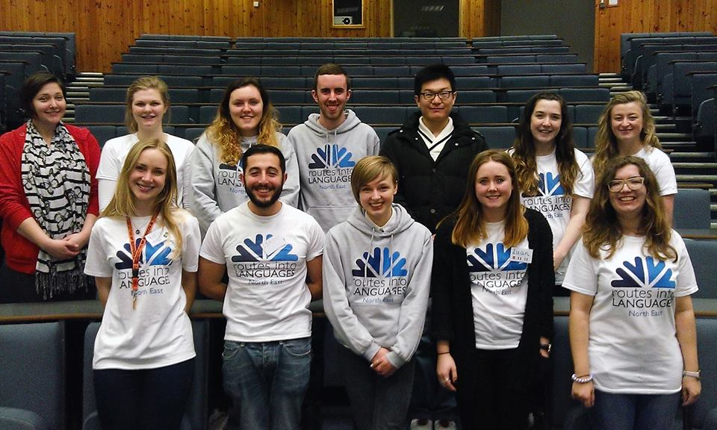
Student Language Ambassadors
“Student Language Ambassadors are not teachers. We are also not pupils. We are somewhere in between.”
Poppy Shuttleworth
Senior Student Language Ambassador 2012-14

Slide 3
Recruitment & Selection
Application: application form and CV with letter of motivation
+
Interview: mini presentation, Q&A and scenario task
+
Training: half-day interactive session regionally with a small number invited to additional national training

Slide 4
The Senior Student Ambassadors
Elite team of 5 dedicated Student Ambassadors
Coordinate school visits via weekly office hours
Help to interview new recruits
Assist with event organisation
Design materials + social media content

Slide 5
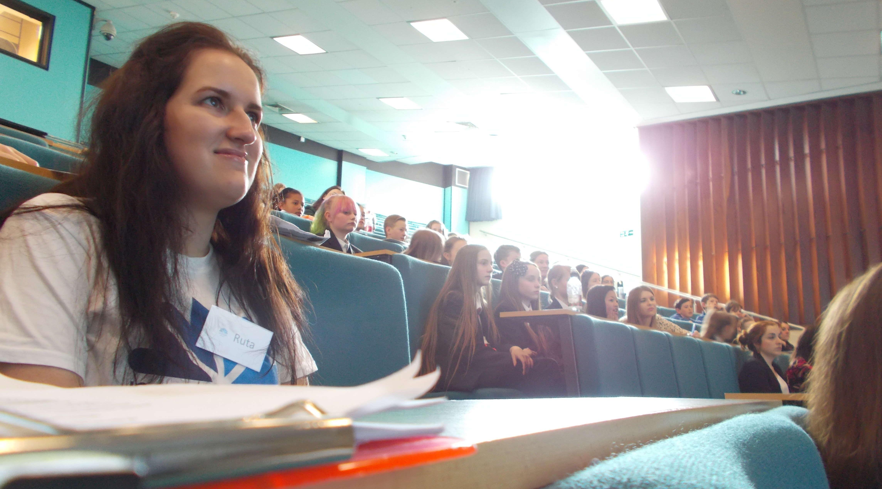
Ruta Vaiciute
Year 2 Modern Languages student
First contact with Routes via Newcastle University Open Days
Application process
Recruitment day
Becoming a Senior Ambassadors
Inspiring others – and each other!

Slide 6
Liam Innis
Final year Modern Languages student from Darlington
Early awareness of Routes at school and college
Senior Student Ambassador since second year developing leadership, organisation + responsibilities
ALL/Routes into Languages Student Language Ambassador of the Year 2015

Slide 7
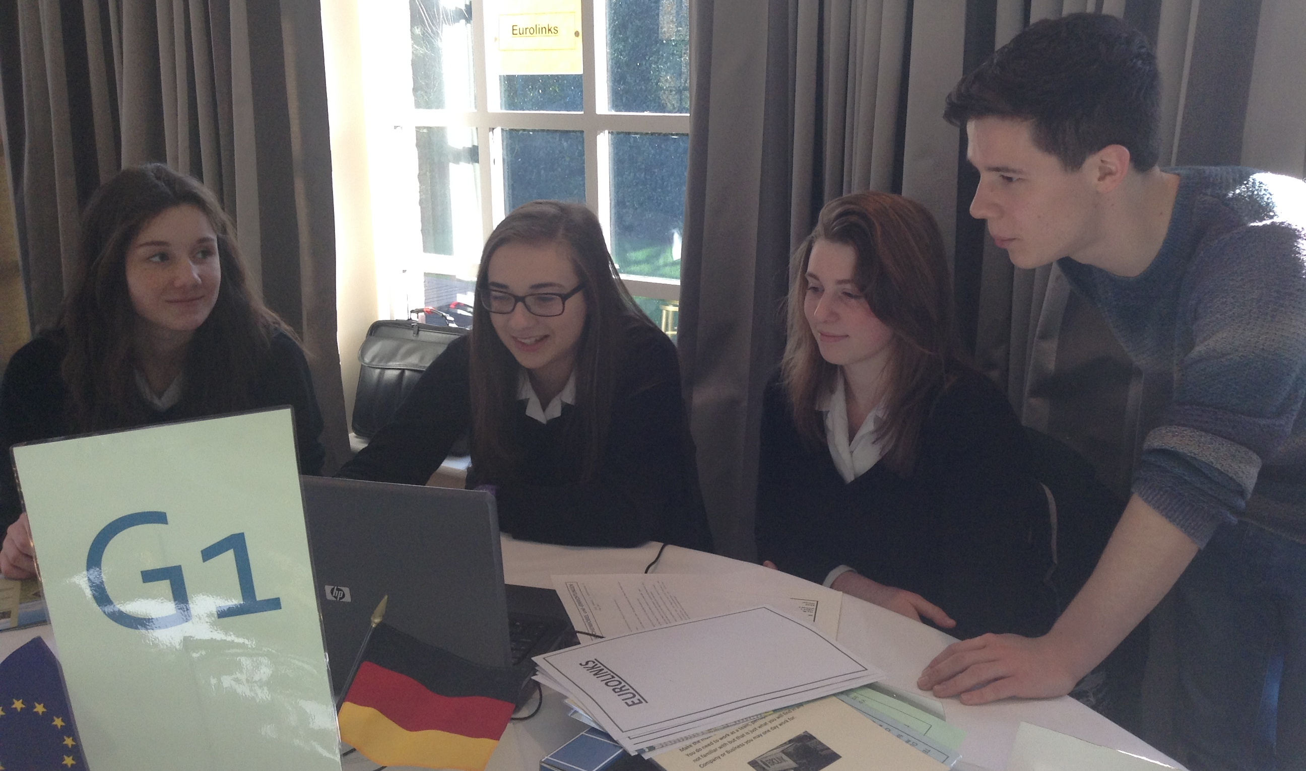
"Liam's ability to inspire shines through in the feedback received from both teachers and pupils. His particular strengths lay in the honesty of his approach and a superb understanding of his audience. In sharing his personal experiences of growing up in the North East, he is able to display a great deal of empathy for the diverse groups of pupils he encounters in his work as a Senior Student Language Ambassador.”
Teacher Feedback:
“Thanks once again! In the evaluation sheets the pupils completed, many commented that working with you was a highlight of their day.”
“Our students really benefited… they were singing your praises! Many have been enthused to continue with languages.”

Slide 8
Benefits & Rewards

Slide 9
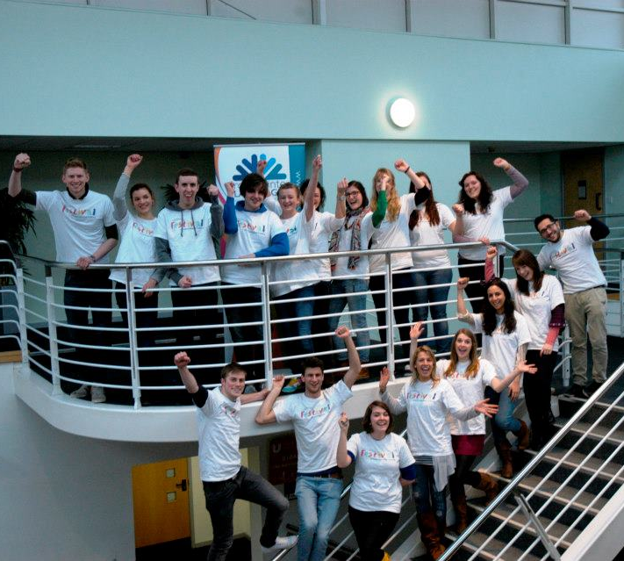
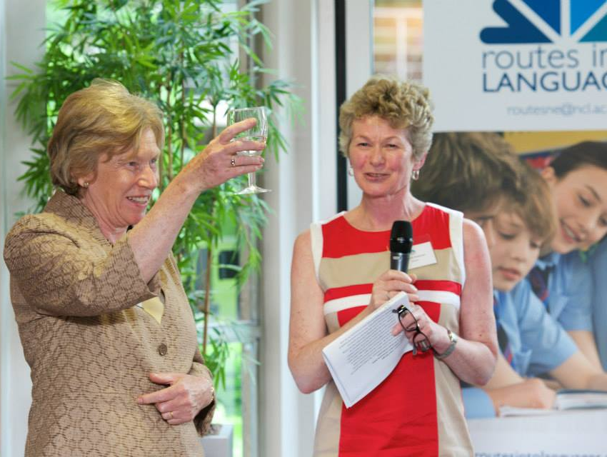
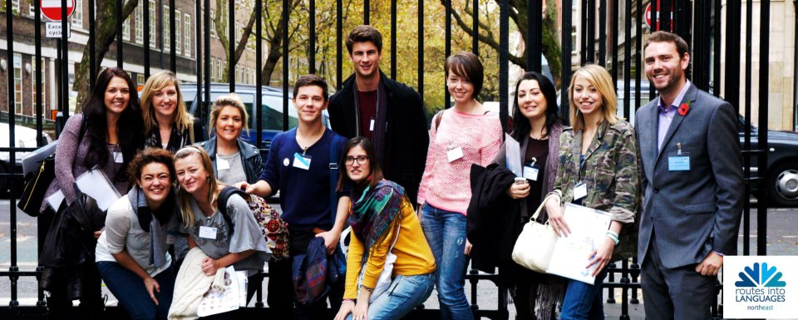
Looking ahead…

